Slide 1
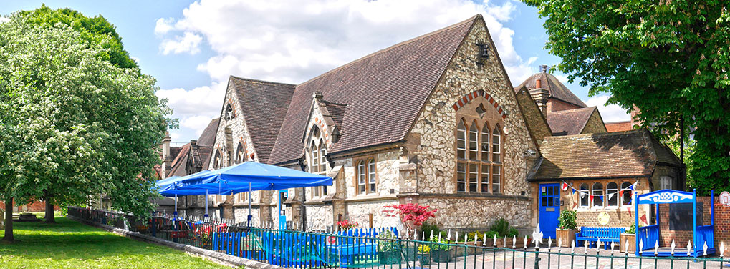
Welcome to St Andrew’s Infant School
Friday 24th April 2026 1.30pm

Slide 2

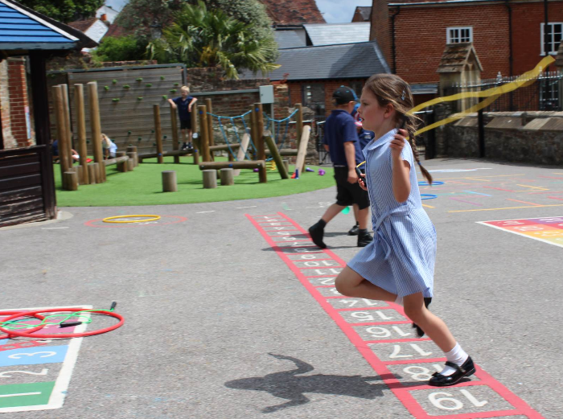

Stay and Play Sessions
Parents’ Meeting
Home Visits
First Day at School

Slide 3
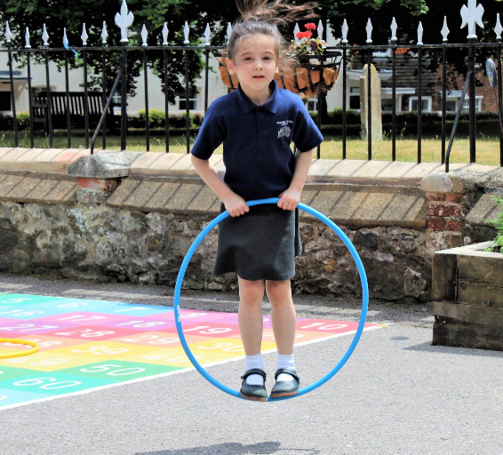
Stay and Play visits to School
Stay and Play Sessions​
Each child will attend two introductory sessions.
Children will be divided into 3 groups of 10 children.
Each session will be 45 minutes long 3:45 – 4:30
 | Session 1 | Session 2
Group 1 | Tuesday 2nd June | Monday 15th June
Group 2 | Wednesday 3rd June | Tuesday 16th June
Group 3 | Thursday 4th June | Wednesday 17th June

Slide 4
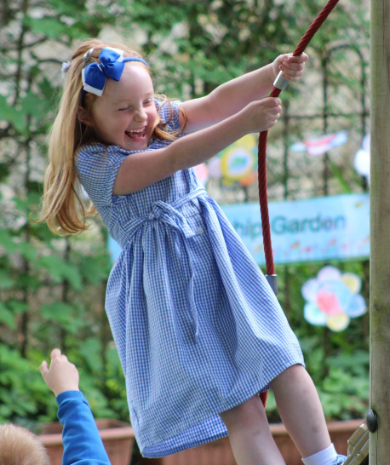
Meeting for New Parents
Meeting for parents to meet the class teacher who will explain your child’s first days at school and the curriculum.
Wednesday 1st July 6.30 pm
St Andrew's school hall

Slide 5
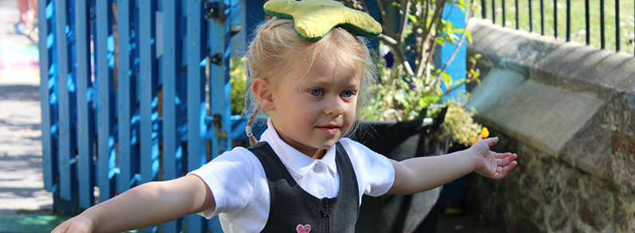
Home Visits
Date | Summer born children | Spring born children | Autumn born children
Wednesday 2nd - Monday 7th September | Miss Gillies will contact you to arrange a visit to your home.

Slide 6
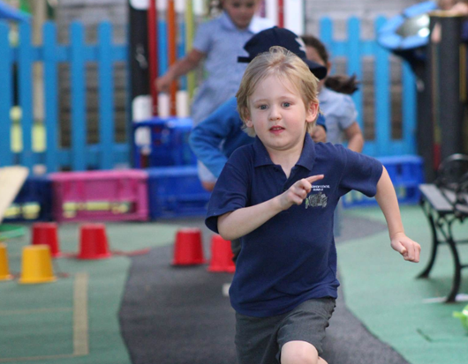
Your Child’s First Day at School
Tuesday 8th September
Summer Born between 1st May – 31st August
Thursday 10th September
Spring Born between 1st January – 30th April
Monday 14th September
Autumn Born between 1st September – 31st December
ALL CHILDREN ARE FULL TIME FROM THEIR FIRST DAY

Slide 7
What will happen next? - Accept your place – by 30th April -Please email the school office, info@standrews-infant.surrey.sch.uk with details of your child’s pre-school/nursery. This week if possible -Once you have accepted your place, the School Office will send you an email giving you your login details for the information database where you will be able to input your child’s information. Please complete this by Friday 22nd May

Slide 8
Thank you
Any questions?

