Slide 1


Anxiety Presentation for parents/carers of children
St. Andrew’s CofE Infant School
Alexis Carpenter

Slide 2
Aims of the session
Define anxiety
Recognise triggers that can cause anxiety
Recognise signs and symptoms of anxiety
Explain cycle of anxiety
Explain how anxiety can be managed
Know where to get help from if needed

Slide 3

What does anxiety mean to you?

Slide 4
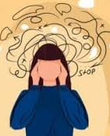
What does anxiety mean?
Anxiety is an emotion we all have. Feeling anxious sometimes is normal. Most of us worry about something. It’s our body’s survival tool which we experience to lesser or greater degrees.
Sometimes our feelings can be overwhelming and we can feel uncomfortable. Uncomfortable feelings can drive us forward into action.
Finding ways of recognising these physical feelings in our bodies helps us to understand them. We can then connect our body and mind to find calm and feel comfortable.

Slide 5
Anxiety Disorders
Generalised anxiety
Separation anxiety
Emotionally based school refusal
Fears and Phobias
Post traumatic stress disorder
(PTSD)
Obsessive Compulsive Disorder
(OCD)
Selective mutism

Slide 6
Thought of a threat or something which may go wrong in the future. Anxiety causes fright and uncertainty. Lasts a short time or can be prolonged. Can affect our ability to eat, sleep, concentrate, travel, leave the house, go to school and work. Can interfere with our enjoyment and take over our lives.

Slide 7
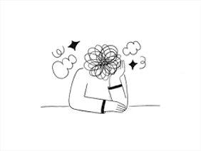
Triggers!!
What worries, scares and frightens us?

Slide 8
Triggers – what worries, scares or frightens us?
Following an adverse event - accident
Significant life events -bereavement/illness/separation/blended families/domestic abuse/bullying/exams
Dogs, spiders, snakes, flying, wasps, buttons
Genetic predisposition – how we are made up
Uncertainty and unpredictability causes feeling of loss of control – A fear of having to do something new or out of our comfort zone.
What worries, scares and frightens us?

Slide 9
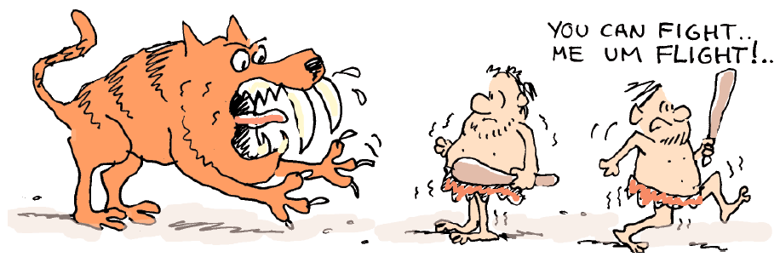
Fight, Flight and Freeze
When our ancestors went out hunting for food they sometimes came across danger.
The danger would trigger an internal worry alarm system in the brain called the Fight or Flight response which is a defence mechanism wired into our brains to get us out of danger and stay safe.

Slide 10
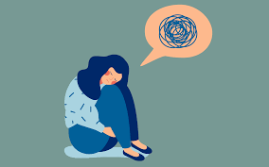
Fight, Flight and Freeze
Anxiety can be a defence mechanism. However...
When it stops your child from enjoying normal life, when it affects their school, work, family relationships, friendships and social activities…..
This is when anxiety has taken over and your child has lost control.

Slide 11
Fight, Flight and Freeze
https://www.youtube.com/watch?v=jEHwB1PG_-Q&t=37s

Slide 12
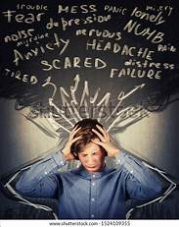
Psychological affects
Insomnia/ nightmares
Irritable
Difficulty concentrating
Loss of self confidence
Depression, Anxiety and Anger can be link
Feeling fearful and panicky
“Frozen” thought processes
Nagging sense of fear
Tearful
Feeling tired

Slide 13

Physical signs of anxiety
Fast / irregular heart-beat
Increased breathing rate / hyperventilation / shallow breathing
Dry mouth or throat
Weak/ tense /tingling or aching of muscles
Feeling lightheaded /headaches/dizziness
Stomach aches or bowel problems
Sweating – hot and cold
“Frozen” to the spot /Tense muscles

Slide 14
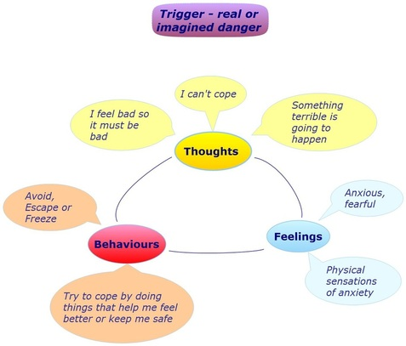
Vicious Cycle of Anxiety

Slide 15
How to support our young people
ACKNOWLEDGE and VALIDATE the young person who is feeling anxious (‘I’ statements- I can see… I understand…)
CONTAIN and challenge anxiety
DISTRACT yourself by doing something you enjoy
WORRY TIME – allocate 15 minutes worry time a day to help contain the worries
THOUGHT DIARY – write down worries and fears and contain to a book you can just shut and close off your worries and fears
TALK to someone – a problem shared is a problem halved

Slide 16
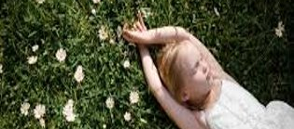
Visualisation

Slide 17
Look after yourself!
EXCERCISE releases endorphins – the feel good hormones
HEALTHY DIET having a health balanced diet, drinking plenty of water
SLEEPING making sure you get 8 hours a night can make a difference on your mood and how you feel
PLANNING AHEAD & BEING ORGANISED
PAMPER YOURSELF do what you enjoy and reward yourself

Slide 18
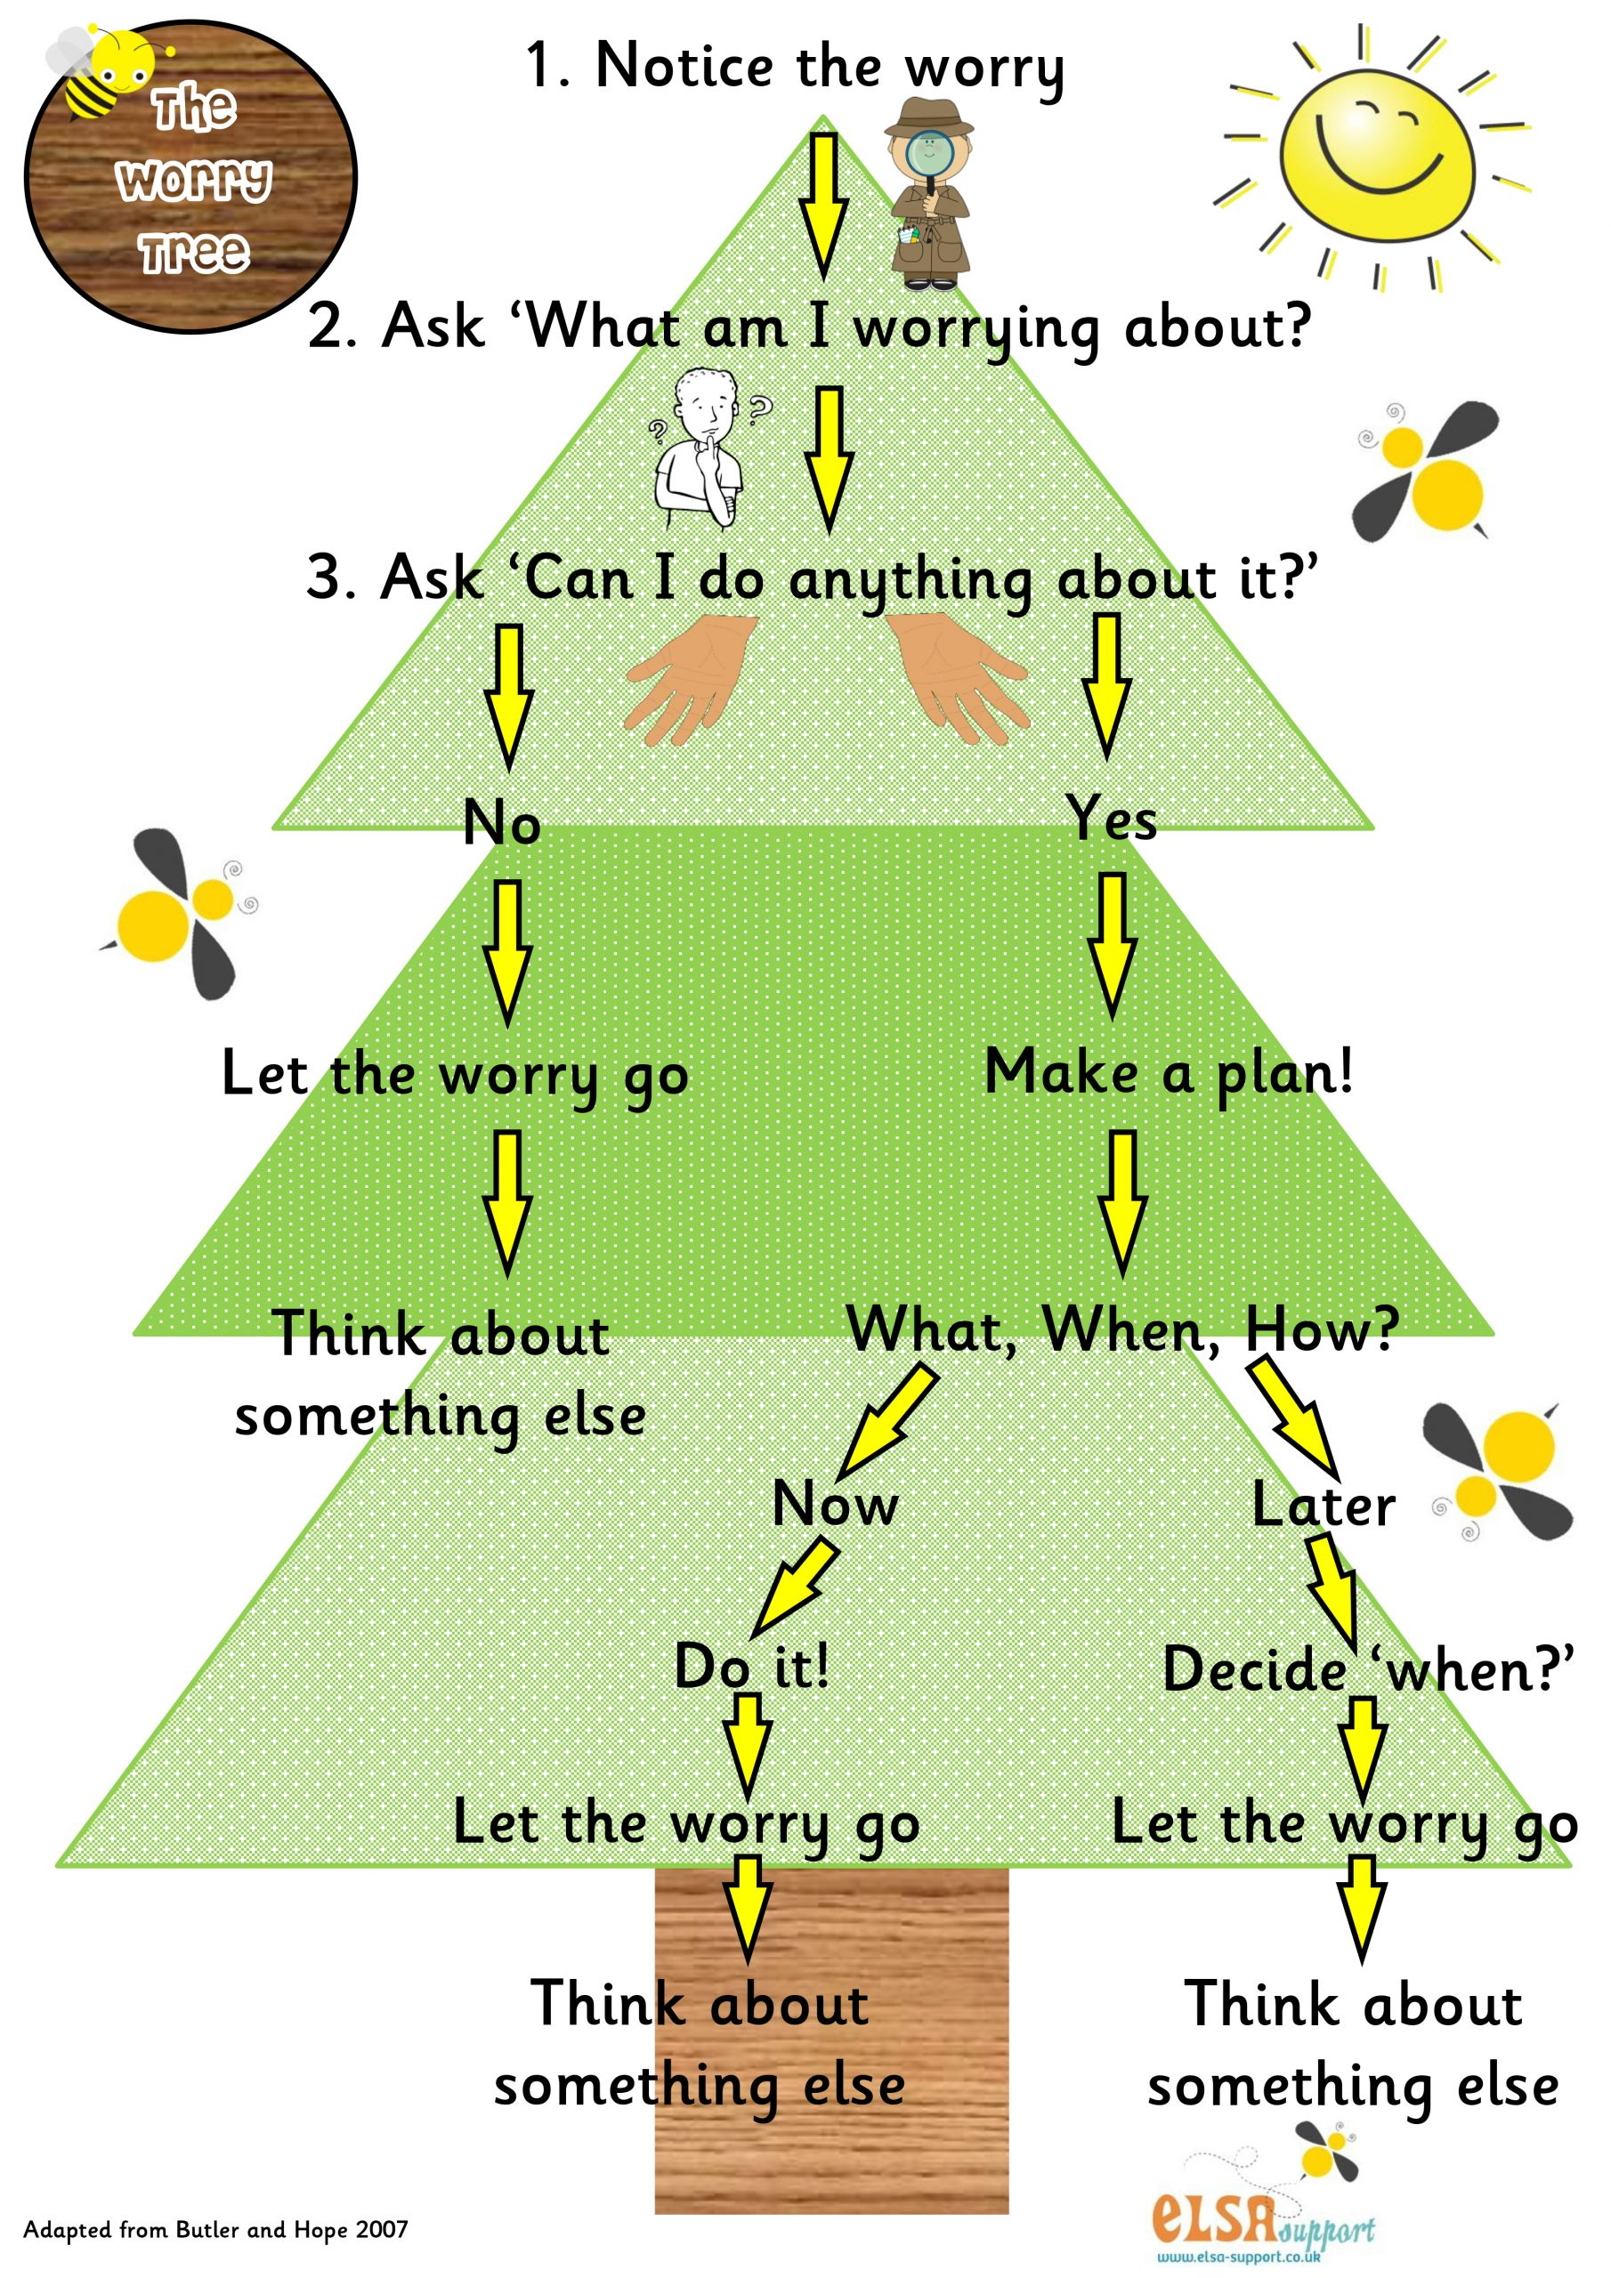
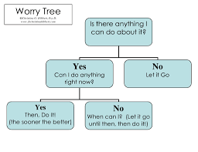
Problem Solving Worries

Slide 19
Summary
Regain control of anxiety not anxiety controlling you
Keep in proportion
Feel the fear and face it anyway
Use coping strategies they WILL work, just keep practicing
Use Distractions & enjoy life don't worry it away!
Knowing where to go and get help if you need it

Slide 20
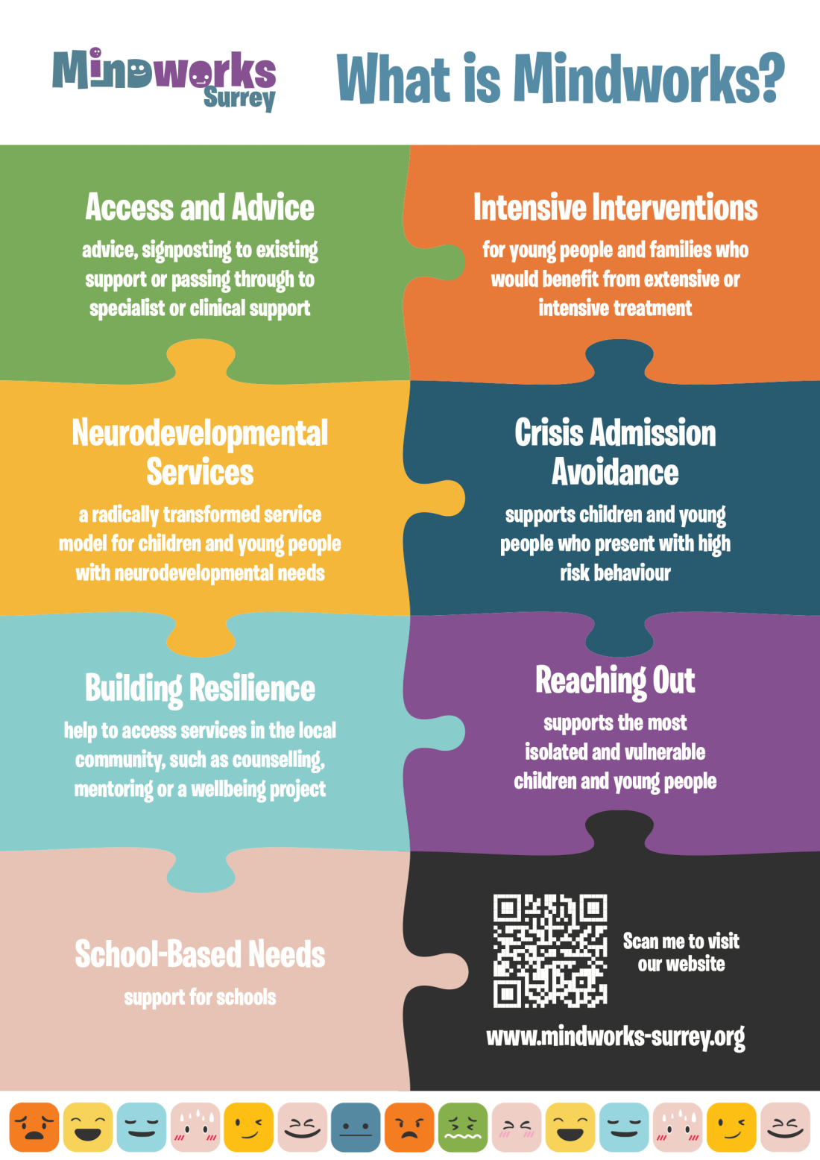
Resources
https://www.mindworks-surrey.org/
There is information for children, young people, families and carers about services,
advice and resources, including how to ask for help in a crisis via the 24/7 Crisis Line.

Slide 21
Useful Websites
Youngminds - http://www.youngminds.org.uk
Child line - https://childline.org.uk
Anxiety UK - www.anxietyuk.org.uk
Mind - www.mind.org.uk
Headspace - www.headspace.com
Calm - www.calm.com

Slide 22
https://www.potters-gate.surrey.sch.uk/Resources-02042020130537/ https://www.potters-gate.surrey.sch.uk/Resources/ https://www.standrews-infant.surrey.sch.uk/Resources/ https://www.standrews-infant.surrey.sch.uk/SEND/

